Slide 2

Node App

Slide 3
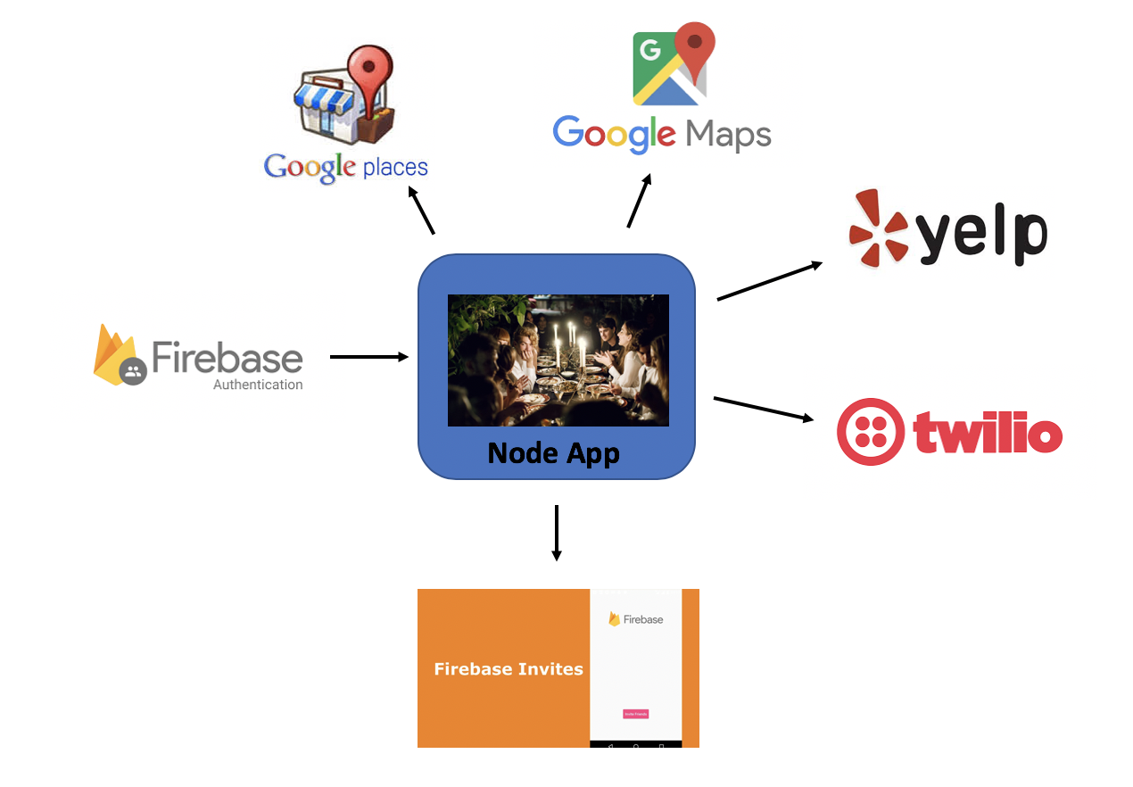
Technologies
Front End
Back End
API Integration

